Slide 1
CSCNSI 2015
Cluster Computing Introduction

Slide 2
Introduction
Parallel Computing
Parallel Programming Models
Server Room Design
Our Server Room

Slide 3
Parallel Computing

Slide 4

Serial Computing
Pretend Bolt has to paint lines on a football field
But he can only go so fast!
Likewise, we can only make one circuit/computer go so fast
Power usage
Heat limits
Size constraints

Slide 5

Parallel Computing
Divide large problems into small problems
In this example, painting each line is an independent task

Slide 6
Parallel Programming Models

Slide 7
Problem Decomposition
Flynn’s Taxonomy
SISD, MISD, SIMD, MIMD
Task Parallelism
Message Passing
MIMD, MISD
Data Parallelism
SIMD

Slide 8
Process Interaction
Shared Memory
Core/CPU multi-threading
Message Passing
MPI
GPU
Cuda

Slide 9
Distributed Systems
Clusters
Many machines networked together
Grid computing
Many machines networked over large geographical area
Cloud computing
Computing as a service

Slide 10
Complications
Limited Resources
NUMA restrictions
Bandwidth (memory, network, I/O, …)
Data storage
Scheduling
Thread scheduling
Job scheduling

Slide 11
Complications
Security
Cleanup between jobs
Physical security
Reliability
Mean time to failure

Slide 12
Types of Clusters
Hardware variance
Homogeneous-hardware cluster
Heterogeneous-hardware cluster (CPU and GPU)
Networking Designs
Hardware (Ethernet, Infiniband, …)
Topology: (Fat tree, torus, hypercube, ...)

Slide 13
Server Room Design

Slide 14
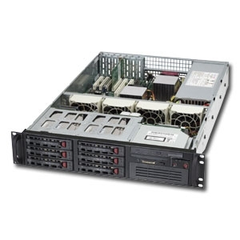
Server Room Design
Node Layout
Each computer (node/server) in a cluster has:
Motherboard
Multiple processors
Memory
Network hardware
Many fans
Hard drives?
Redundancy (power supplies)
Exhaust
Intake

Slide 15
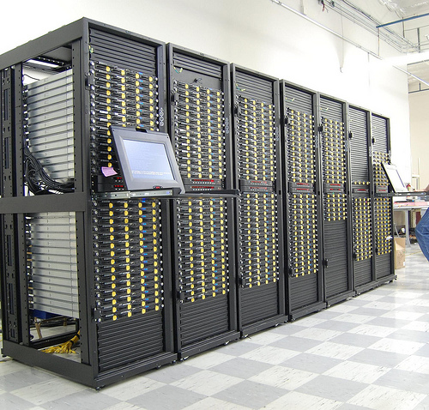
Server Room Design
Cabinet Design
Holds nodes (10 - 30)
Consumes lots of power (10 - 100kW)

Slide 16
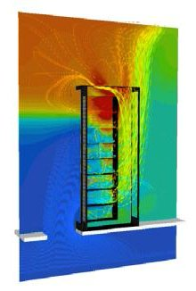
Server Room Design
Cabinet Design
Gives off a lot of heat!
Heat needs to be removed
Proper server room
Sufficient cooling
Organized room layout

Slide 17
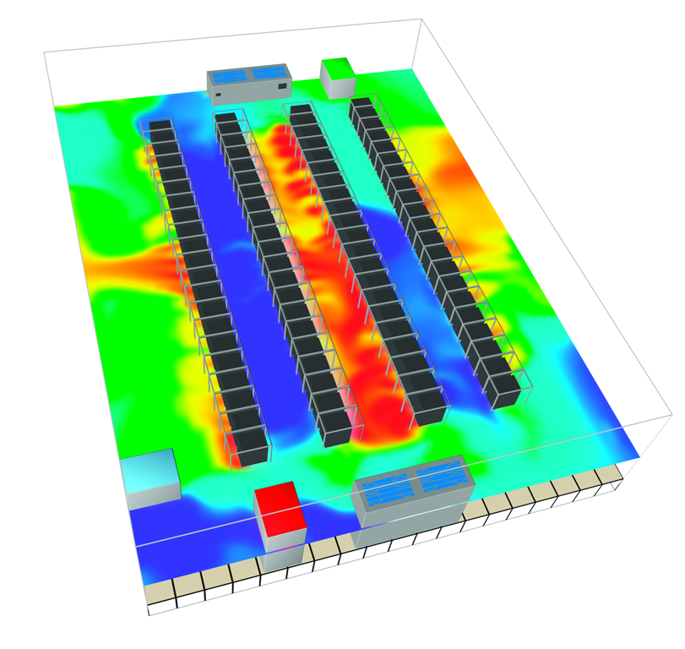
Server Room Design
Aisles and Cooling
Racks are typically assembled into aisles
Front facing toward cold aisle
Back facing toward hot aisle
Back to back, front to front

Slide 18
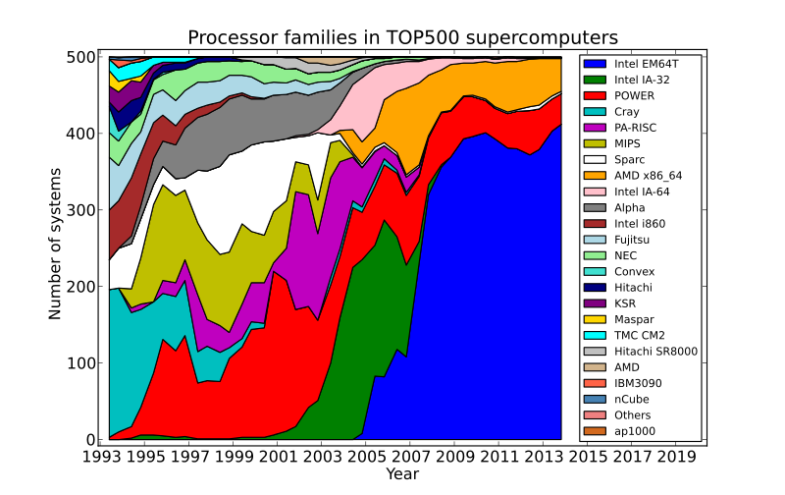
Server Room Design
Future Trends
Server density is increasing
Cooling is getting creative
Power demands are becoming massive
Heterogeneous hardware
More GPGPU systems

Slide 19
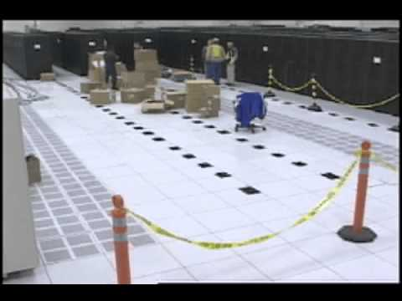
Server Room Design
Roadrunner Installation

Slide 20
Our Server Room

Slide 21
Our Server Room
Layout
Will be loud!
1 rack per group
11 computers (nodes) per rack
HP ProLiant DL380p Gen8
FDR InfiniBand (56Gb/s) =AND= 40GigE
1 w/ DVD drive; redundant power supply
10 compute nodes
1 3Com 1GigE managed switch
1 Mellanox Infiniband Switch

Slide 22
Our Server Room
Room kept below 70°F
Bring a jacket
There will be absolutely no touching of other equipment in the server room.

Slide 23
More Rules
Never prop a door open
Absolutely NO food or drink
Use earplugs
Must be accompanied by at least one of the following:
Instructor, TA, Mentor
Do not plug/unplug anything into/from active circuit
No subfloor access

Slide 24
Summary

Slide 25
Summary
Parallel Computing
Parallel Programming Models
Server Room Design
Our Server Room

